Slide 1
Graph Representation

Slide 2
Edge list
Adjacency Matrix
Adjacency List

Slide 3
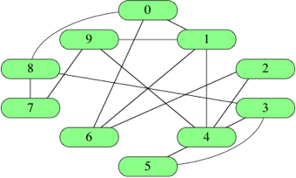
Edge List
[ [0,1], [0,6], [0,8], [1,4], [1,6], [1,9], [2,4], [2,6], [3,4], [3,5], [3,8], [4,5], [4,9], [7,8], [7,9] ]

Slide 4
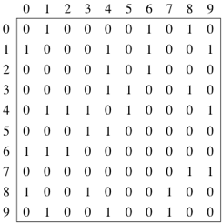
Adjacency Matrix

Slide 5
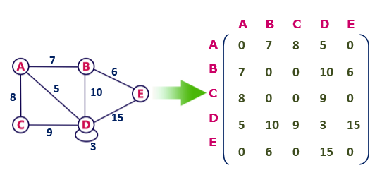
Undirected weighted graph represenation

Slide 6
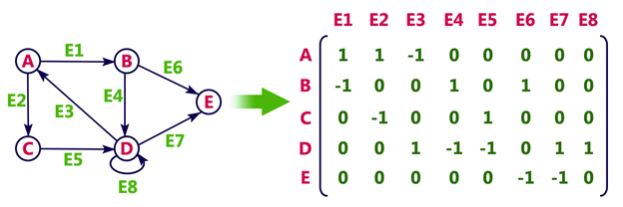
Directed Graph

Slide 7
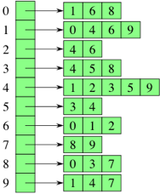
Adjacency List

Slide 8
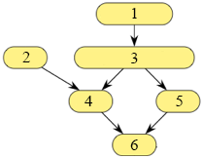

Slide 9
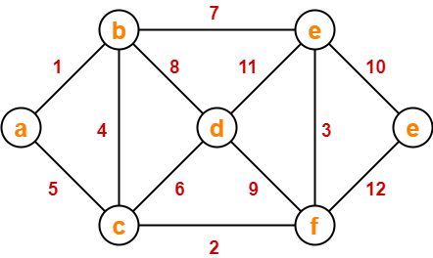
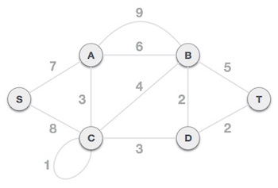
Solve

